Slide 1
Introduction to the Center of Excellence for African Swine fever Genomics
Dr. Douglas Gladue
Director Center of Excellence for ASFV
Senior Scientist USDA – Plum Island Animal Disease Center
Scientific Director - GARA
Treasurer – World Society of Virology

Slide 2
COE: Solving ASFV Community Problems
Stand Up by ASFV group at PIADC
Community Driven: Suggestions welcome
MOU for partnerships is pending approval
One stop automatically updated ASFV protein database
Information on individual ASFV proteins in one place
Continuous update linking new publications
Structure predictions for all ASFV proteins
Georgia structures finished
Variant proteins from other isolates coming soon
Online sequencing platform
Collaboration with Paolo Ribeca ( funded, expected Beta Launch Soon)
Repository of well characterized ASFV isolates for distribution
Relies on GARA members to allow there characterized strains to be distributed freely
Standardization of ASFV studies
Pathogenesis
Vaccine Efficacy and Cross-Protection

Slide 5
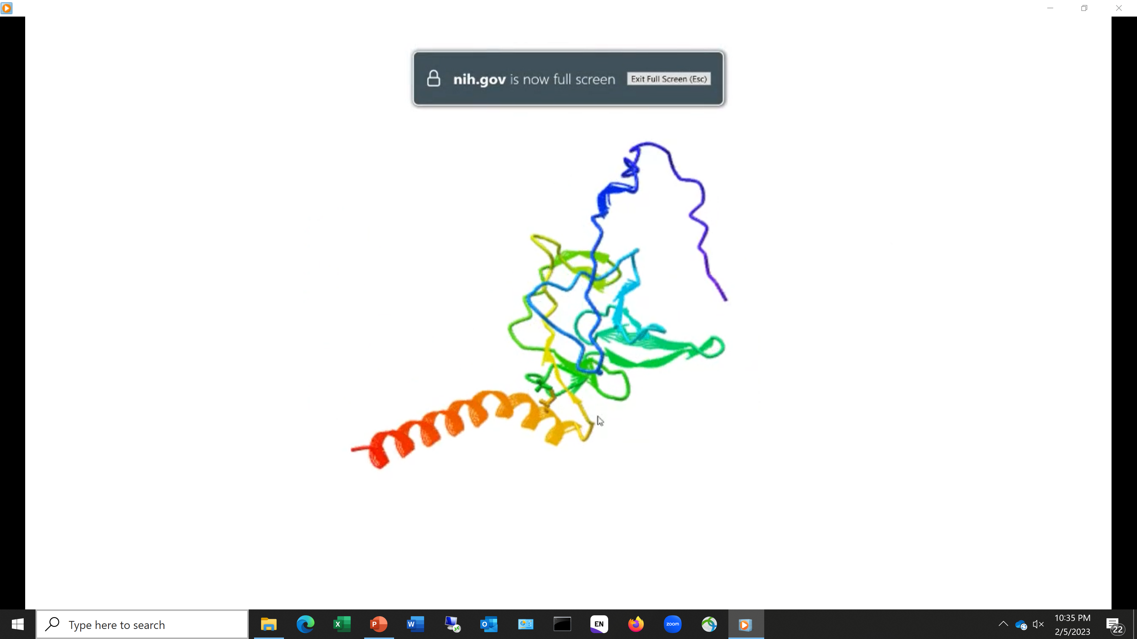
Rotate and view each protein structure
Future features
Overlapping structures of protein variants from other isolates
Ability to highlight potential immune epitopes

Slide 7
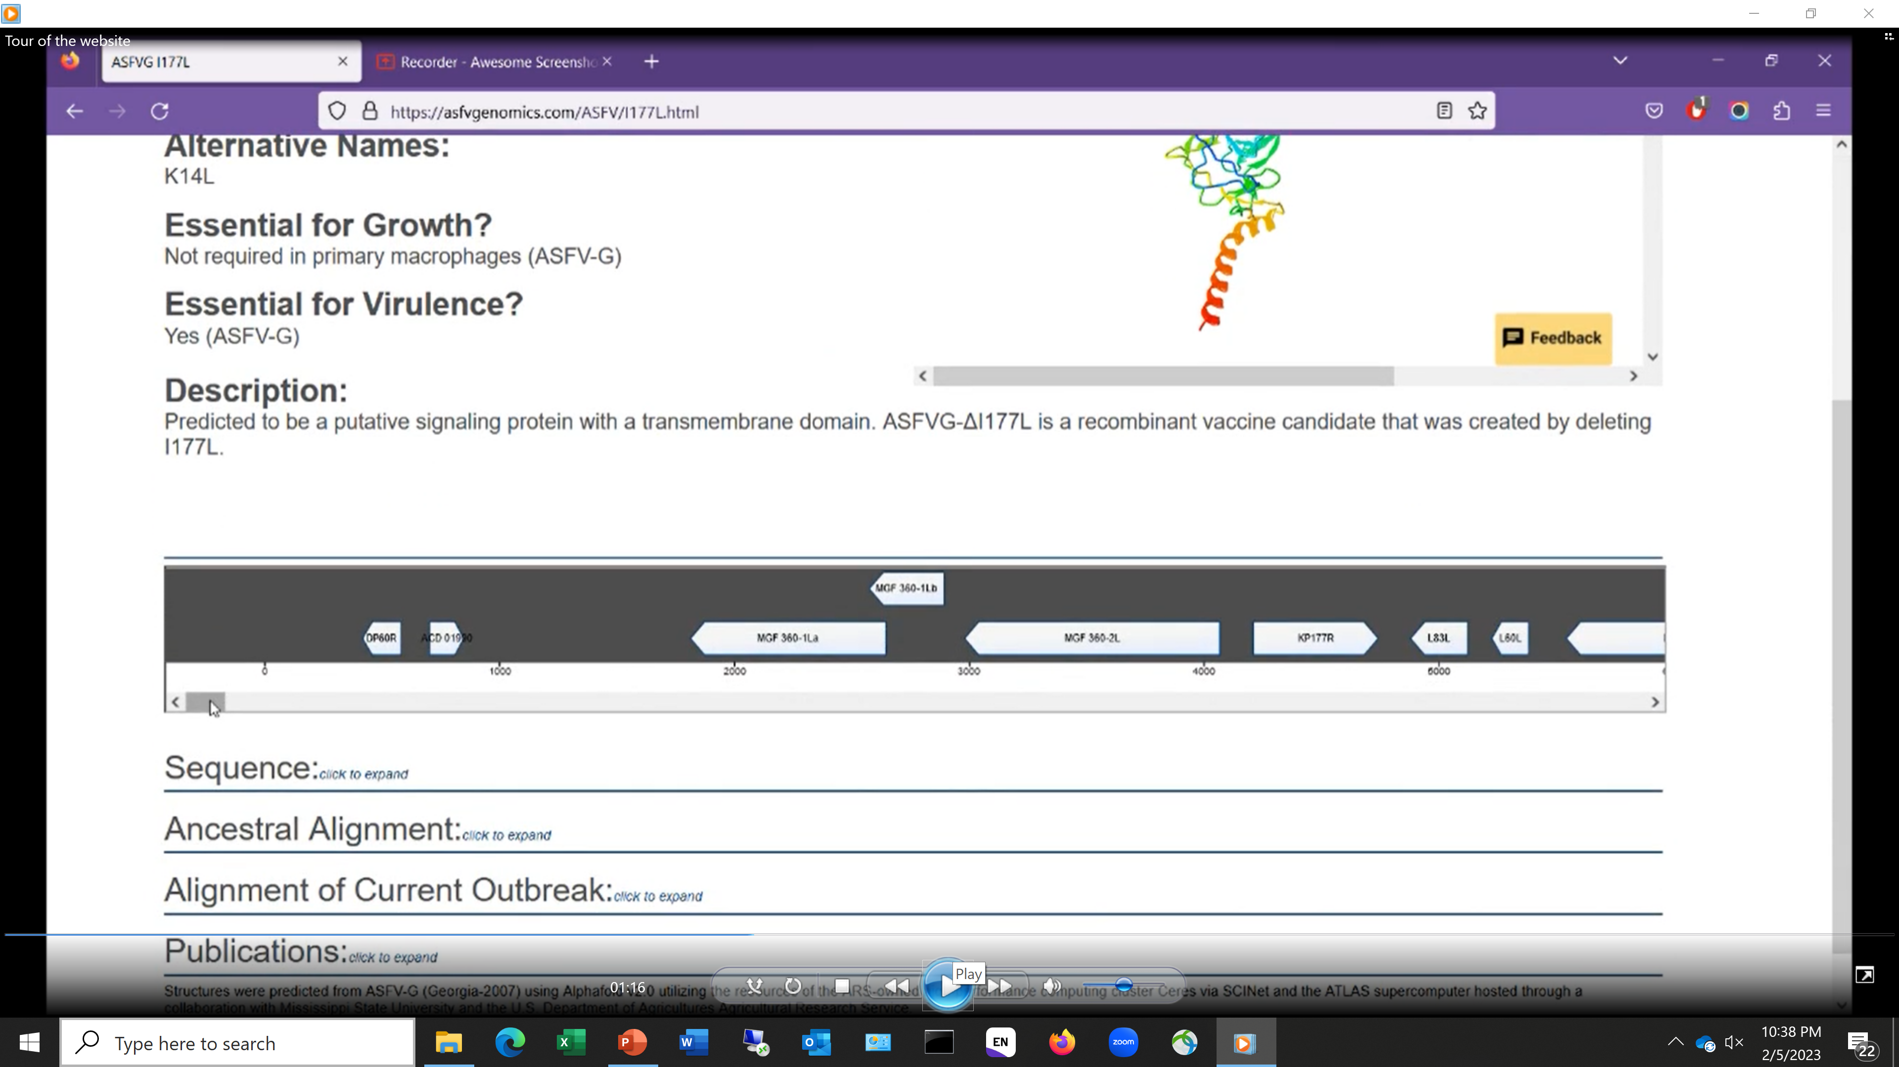

Slide 11
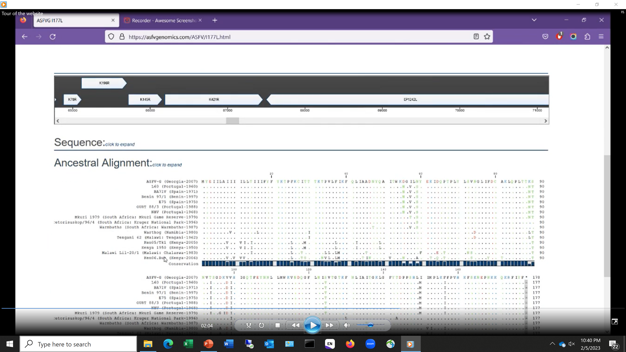

Slide 13
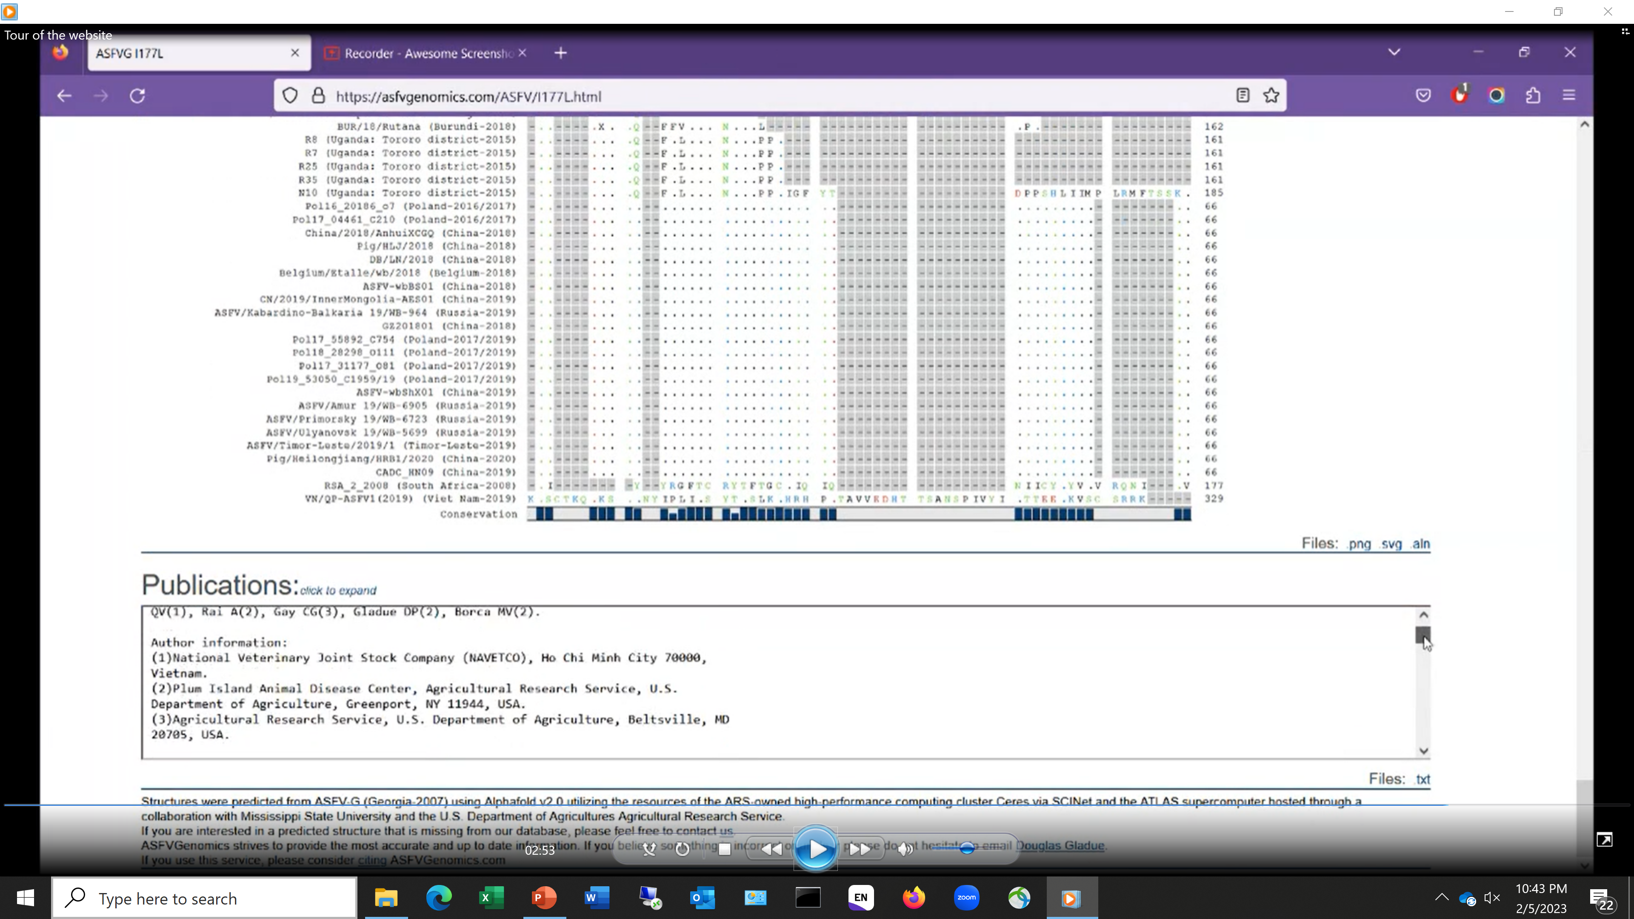

Slide 14
Launched GARA in DR
Initial 6 months
51 countries, 279 cities
9K page views by 1.2K unique users

Slide 15
Repository ASFV isolates for distribution
Project designed between Plum Island and Pirbright
Only Virulent Strains
Only restriction is distribution of unmodified isolates
Traceability requirements for distributing ASFV
Once modified the receiving lab has ownership
Free and Clear MTA for any derivative
Nagoya exemptions for included strains
Help from Partners in Africa
LIRI has agreed to collaborate to contribute Kenya Isolates

Slide 16
Proposed Strains Included
Isolate Genotype
E75 I
Ba71 I
Georgia (2010) II
Bot/1/99 III
Tengani V
SUM14/11 or Malawi VIII
Ken06 IX
Uganda 1965 X
KAB 6/2 XI
NYA ½ XIV
Pr 96/4 XX
Covers :Genotypes I , II, III, V,VIII,IX,X,XI, XIII, XIV, XX
Strains from Plum Island and Pirbright Historical collections
Collection intended to evolve or expand for Relevant circulating strains
Possibility for an Expanded collection if there is a need.
ASFV Community Input?

Slide 17
Solving ASFV Community Problems: ASFV sequencing
Collaboration with Paolo Ribeca
Leveraging Scinet (ARS bioinformatics computer core)
Centralized Banking and long-term storage of raw data and sequences
Automatic backups to remote locations
Ensures long term survival with minimal costs
Private dashboard for Researchers to use tools on there raw sequencing data
(pre-publication)
Raw data analyzed using same pipeline automatically with little to no input required
Ability to re-analyze in the future for published genomes should a mistake be commonly made ( i.e. missing 2kb)
Ability for any ASFV lab can submit raw data
Automatic annotation/ denovo assembly
Quality scores for each nucleotide calculated to allow for viewing and export

Slide 18
Solving ASFV Community Problems: ASFV sequencing
Input raw data directly from Sequencer or uploaded
Illumina (via basespace transfer or direct upload)
Oxford Nanopore
PacBio?
Thermofisher Ion?
Output annotation files required for NCBI submission
Standardizes ASFV genome sequence quality
Having access to a NGS Sequencer, still requires a bioinformatic pipeline
Many labs have access to a sequencer or sequencing core facility, but lack bioinformatic capability
Could allow developing countries with ASFV outbreaks the ability to sequence rapidly outbreak strains

Slide 19
Solving ASFV Community Problems: ASFV sequencing
Registration and signing of MOU Free to use Bioinformatics platform
Link and track different ASFV variants to WOAH WAHIS outbreak maps
As close to real-time ASFV variant tracking as possible
Initial Goal is 3 months from outbreak to Sequence for 2023
Shipments sent to PIADC
Local sequencing of outbreaks, goal is to have output file within 1-2 days
Hi Quality denovo sequencing requires both long and short reads
Variants aligning to a reference one sequencing platform

Slide 20
Partnerships to Expand Sequencing of African Isolates Funded from USDA-ARS NBAF partnership funding
Ghana :Dr. Theophillus Odoom ; Dr. Jehadi Osei-Bonsu ; Dr. Fenteng Danso
Veterinary Services Directorate (VSD) Research Farms and Accra Veterinary Laboratory
Dr. Aruna Ambagala: Canadian Food Inspection Agency (CFIA)
Nigeria : Dr. Pam Luka: National Veterinary Research Institute (Biotechnology Centre)
Mozambique: Dr. Carlos Quembo:Agricultural Research Institute of Mozambique Central Region Centre (IIAM-CZC)
Benin: Dr. Okri Fréjus Hans OHOUKO; Dr. Victorien Dougnon
Research Unit in Applied Microbiology and Pharmacology of Natural Substances (U.R.M.A.Pha.)
University of Abomey-Calavi
Togo: Dr. Damitoti YEMPABOU : Institut Togolais de Recherche Agronomique (ITRA)
Uganda: Dr. Deo Ndumu: Ministry of Agriculture, Animal Industry, and Fisheries
Dr. Eddie Wampande:College of Veterinary Medicine, Animal Resource, & Biosecurity, Makerere University
Sierra Leone: Dr. Sahr Raymond Gborie: Livestock & Veterinary Services Division, Ministry of Agriculture &Forestry
Burkina Faso: Dr. Zerbo Habibata: Direction Générale des Services Vétérinaires (DGSV)
Dr. Michael Dione : International Livestock Research Institute (ILRI)

Slide 21
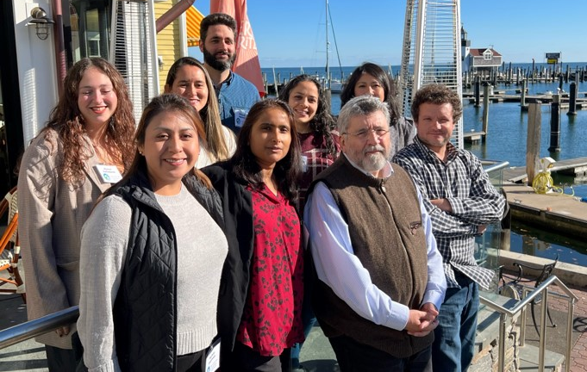
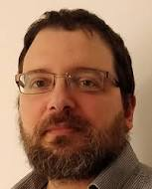
Other Community Problems?
Standardizing ASFV annotation ( similar to poxvirus )?
Expansion into Other Diseases: Lumpy Skin Disease Virus
Cyril Gay
Paolo Ribeca
Mark Dinhobl – Data Scientist/Computer Programmer
Nicholas Tessler – Website Design

